Slide 1
Measures of Effective Teaching
Final Reports
February 11, 2013
Charlotte Danielson
Mark Atkinson
Notes:
Change the title and subtitle to fit your presentation and audience

Slide 2
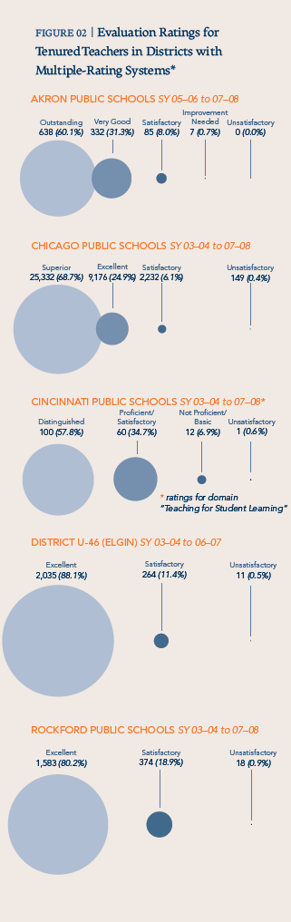
Why? The Widget Effect

Slide 3
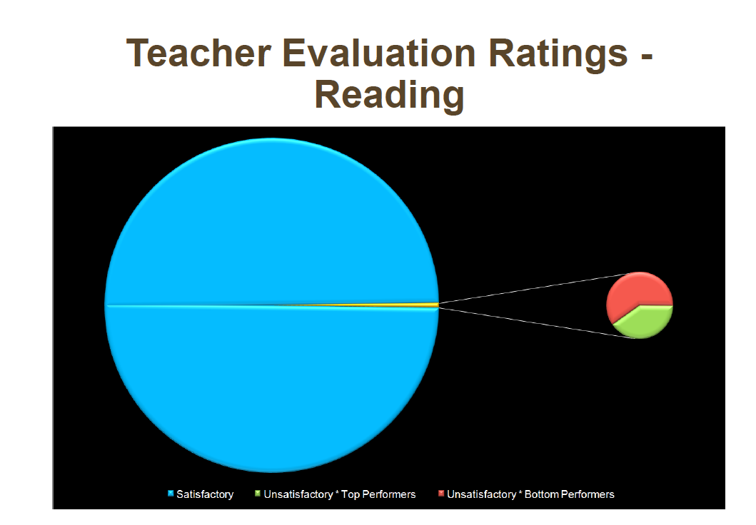
Traditional Systems Haven’t Been Fair to Teachers
Performance Evaluation in Los Angeles Unified 2008
Teacher Hiring, Transfer and Evaluation in Los Angeles Unified School District, The New Teacher Project, November 2009

Slide 4
Essential Characteristics of Systems of Teacher Evaluation
Accurate, Reliable, and Valid
Educative

Slide 5
Why is Accuracy Important?
High Rigor Low ←--------------------------------------- | Level of Stakes -------------------→High
Low Rigor
Notes:
System Design
Given what I have said thus far, we can think of two continua related to evaluation systems: one related to the level of stakes, (in the form of licensing, employment, or compensation) and the other concerning the rigor of the system (the clarity of the criteria, the design of the items to be assessed, the training of the assessors, etc.) If one maps one continuum on the other, the result is a graph with four quadrants like this one. (Show the graph.)
In the quadrant where both the stakes and the rigor are low (for example in most mentoring programs) there are no negative consequences of the low rigor. That is, the mentoring program may not be as good as it might be, but no one is harmed. Those systems with both high stakes and high rigor (for example, where the assessors go through extensive training and must pass a proficiency test - as in Praxis III and National Board) the result is a system with high levels of credibility and defensibility.
The difficulty arises, I think, where the system has high stakes but low rigor (and therefore low defensibility and credibility.) In those situations there is opportunity for harm, and mischief, and abuse. Those are the ones that really worry me. I also wonder whether the infrastructure required to establish, and maintain, a system of high rigor, is worth the benefits. It will be interesting to see the situations in which it turns out to be worth it.

Slide 6
Beware High-Stakes, Low-Rigor Systems
High Rigor Structured Mentoring Programs, e.g. New Teacher Center Low ←--------------------------------------- | National Board Certification Praxis III Level of Stakes -------------------→High
Informal Mentoring Programs Traditional Evaluation Systems Low Rigor | DANGER!!
Notes:
System Design
Given what I have said thus far, we can think of two continua related to evaluation systems: one related to the level of stakes, (in the form of licensing, employment, or compensation) and the other concerning the rigor of the system (the clarity of the criteria, the design of the items to be assessed, the training of the assessors, etc.) If one maps one continuum on the other, the result is a graph with four quadrants like this one. (Show the graph.)
In the quadrant where both the stakes and the rigor are low (for example in most mentoring programs) there are no negative consequences of the low rigor. That is, the mentoring program may not be as good as it might be, but no one is harmed. Those systems with both high stakes and high rigor (for example, where the assessors go through extensive training and must pass a proficiency test - as in Praxis III and National Board) the result is a system with high levels of credibility and defensibility.
The difficulty arises, I think, where the system has high stakes but low rigor (and therefore low defensibility and credibility.) In those situations there is opportunity for harm, and mischief, and abuse. Those are the ones that really worry me. I also wonder whether the infrastructure required to establish, and maintain, a system of high rigor, is worth the benefits. It will be interesting to see the situations in which it turns out to be worth it.

Slide 7
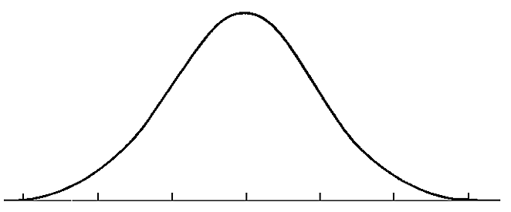

Why “Educative”?
Number of Teachers
“Teacher Effectiveness”
Notes:
Of course, if the goal is the improvement of teaching, one must define “teaching” in such a way that the definition captures our collective vision of how classrooms should be. Hence the fft.

Slide 8


Final MET Reports

Slide 9
The Measures of Effective Teaching project
Teachscape video capture, on-line training, and scoring tools
23,000 classroom videos from 3,000 teachers across 6 districts
On-line training and certification tests for 5 teaching frameworks
  Framework for Teaching
  CLASS
  MQI (Math)
  PLATO (ELA)
  QST (Science)
1,000+ raters trained on-line
Over 50K+ scored videos
New York
City
Pittsburgh
Denver
Memphis
Charlotte-Mecklenburg
Dallas
Hillsborough
County
Notes:
Teachscape’s panoramic video capture, sharing, and scoring tools have been used to capture and score more than 23,000 lessons in over 3,000 classrooms across six states. Each lesson was scored multiple times against multiple frameworks using Teachscape’s software. These 23,000 lessons were scored over 80,000 times using Teachscape software to render valid, reliable evaluations.

Slide 10
Big Ideas
Final MET reports anoint FfT as the standard-bearer of teacher observation
Messaging from Gates (and now others) is all about feedback for improvement
Multiple measures – including student surveys – are here to stay
Video and more efficient evaluation workflows are the next horizon
Push for multiple observers is on (in the name of accuracy)
Increasingly all PD investments are going to be driven by and rationalized against evaluation outcomes – linkage of Learn to Reflect will be a key differentiator for Teachscape
Multiple factors (demographics, cost, reform efforts) will finally galvanize commitment to so-called “iPD”
Analytics are everything – workflows without analytics will not compete
Just as the ink dries on teacher evaluation reform, the tsunami of Common Core implementation will wash over it, impacting everything from the instruments we use to the feedback we give, but not discarding evaluation itself

Slide 11
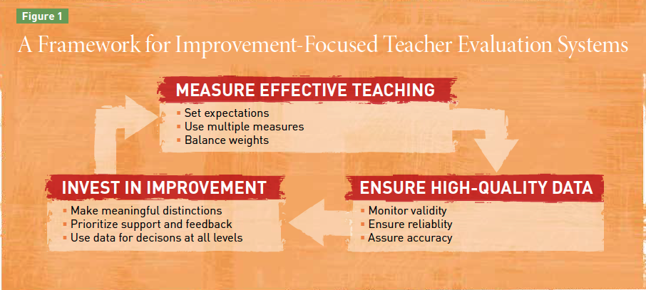
Getting Evaluation Systems Right

Slide 12
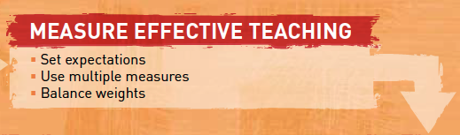
Student surveys are here to stay, but they are expensive and complicated
to administer on their own and will need to be more tightly coupled to
the other dimensions of evaluation – notably observations
MET recommends “balanced weights” means 33% to 50% value added
measures, and there is likely to be significant debate about this

Slide 13
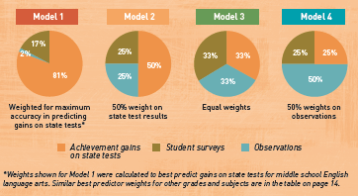
Weighting the Measures

Slide 14
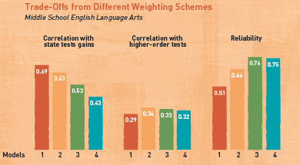
Outcomes of Various “Weights”

Slide 15
Aldine Project
FfT Component
3a: Communicating with Students
Expectations for learning
Directions for activities
Explanation of content
Use of oral and written language
3b: Using Questioning and Discussion Techniques
Quality of questions
Discussion techniques
Student participation
Student Survey Questions
My teacher explains information in a way that makes it easier for me to understand.
My teacher asks questions in class that make me really think about the information we are learning
When my teacher asks questions, he/she only calls on students that volunteer (reverse)

Slide 17
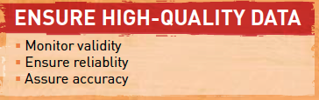
Validity – the degree to which the teacher evaluation system predicts
student achievement, as the district chooses to measure it;
Reliability – the degree to which the evaluation systems results are not
attributable to measurement error;
Accuracy – “reliability without accuracy amounts to being consistently
wrong.”

Slide 18
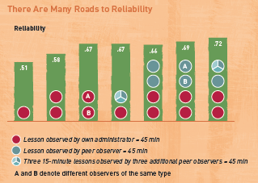
Increasing Reliability With Observations

Slide 19
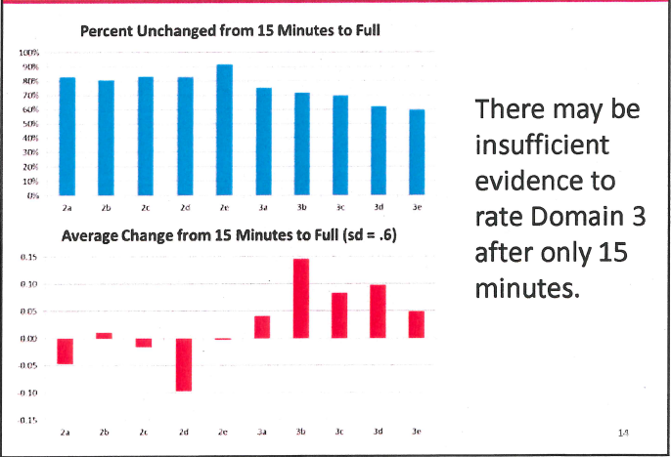
15 Minute Ratings May Not Fully Address Domain 3
Source: Andrew Ho & Tom Kane Harvard Graduate School of Education
MET Leads Meeting September, 28, 2012

Slide 20
Principals & Time
Informal Observation
Classroom Observation | 1
Analysis & Scoring | 0.5
Post-Observation Conference | 0.5
Total | 2
Formal Observation
Scheduling & Planning | 0.25
Pre-Observation Conference | 0.5
Classroom Observation | 1
Analysis & Scoring | 0.5
Post-Observation Conference | 0.5 |  | 1 Informal |  | 2 Informal |  | 2 Informal
Total | 2.75 |  | 1 Formal |  | 1 Formal |  | 2 Formal
 |  |  | 3 Walks |  | 3 Walks |  | 3 Walks
Walkthroughs
Individual Unscheduled Walks | 0.1 |  | assumes 28 teachers per principal
Total Principal Hours on Evaluation |  |  | 141.4 |  | 197.4 |  | 274.4
The model chosen has serious implications on time.
Should that be a deciding factor?

Slide 21
Scoring Accuracy Across Time¹
¹Ling, G., Mollaun, P. & Xi, X. (2009, February). A study of raters’ scoring accuracy and consistency across time during the scoring shift. Presented at the ETS Human Constructed Response Scoring Initiative Seminar. Princeton, NJ.

Slide 22
Efforts to Ensure Accuracy in MET
Training & Certification
Daily calibration
Significant double scoring (15% - 20%)
Scoring conferences with master raters
Scoring supervisors
Validity videos

Slide 23

White Paper on Accuracy

Slide 24
Understanding the Risk of Teacher Classification Error
Maria (Cuky) Perez & Tony Bryk

Slide 25
False Positives & False Negatives
Making Decisions about Teachers Using Imperfect Data Perez & Bryk

Slide 26
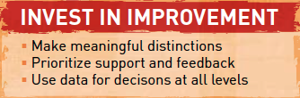
1-4 means nothing – 50% of the MET teachers scored within 0.4 points of
one another:
  Teachers at the 25th and 75th percentile scored less than one-quarter
  of a point above or below the average teacher;
  Only 7.5% of teachers were less than 2 and 4.2% were greater than 3;
Video is a powerful tool for feedback;
Evaluation data should drive professional development spending priorities.

Slide 27
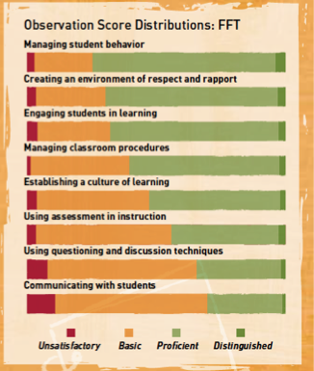
MET, FFT & the Distribution of Teaching

Slide 28
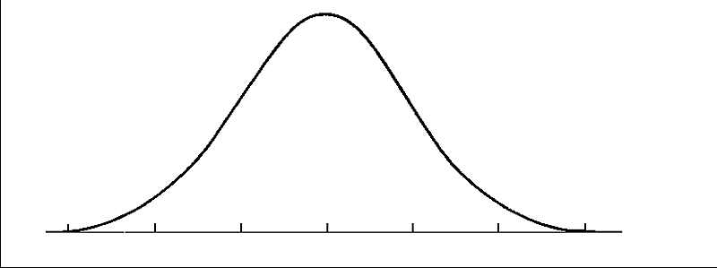
First there was the Widget Effect (“Wobegon”)

Slide 29
MET Showed a Very Different Distribution of Teachers

Slide 30
One Story from Florida

Slide 31

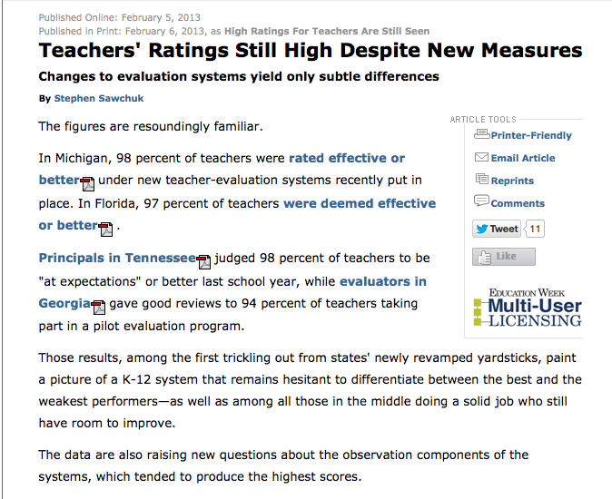
It’s Not Just Florida

Slide 32
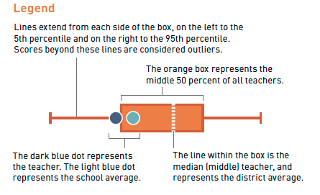
Visualizing Information

Slide 33
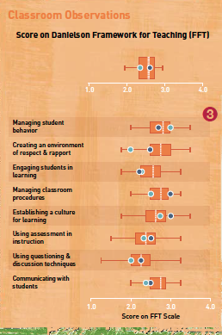
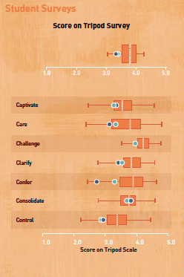
Visual Supports For Feedback

Slide 34
An Educative Approach to Evaluation Process
Short cycles
(3-4 weeks)
Baseline observation
sequence
Informal observation,
joint lesson analysis,
review of PLP &
designation of new
goals, if appropriate
Informal observation,
joint lesson analysis,
review of PLP &
designation of new
goals, if appropriate
Professional
Learning
Plan
Implementation of new
planning, content or
strategies
Implementation of new
planning, content or
strategies
Student work collected
during the observation to
assess cognitive demand
Student work collected
during the observation to
assess cognitive demand

